Slide 1

face recognition attendance system
Section Name :A17 Group Number :08
Project Team Members :-
Guided by:
Ms.M.Chiradevi Mam
S.No | Name | Admission no | Register no
1. | G. Kula theja (L) | 20229003 | 99220041184
2. | Vivek kumar | 20225379 | 99220041417
3. | Mrinmoy Dewraja | 202210238 | 99220041265

Slide 2
ABSTRACT
The project we are doing is face recognition attendance system using python.
A face recognition attendance system automatically identifies and confirms a person and records attendance based on their face detection. Face recognition attendance systems are catching the attention of both small and large businesses.
Face Recognition is a system developed for daily student attendance in schools, colleges and institutes. Face recognition is a trending technology almost utilized in every area from security, research, automation and lots of more things. And that we are aiming and targeting on the attendance of the scholars by applying OpenCV and a few python’s inbuilt functionality.
we've got also used text to speech library.
A face recognition attendance system is a tool that uses facial recognition technology to identify a person using his/her facial features and automatically marks the presence of the person.

Slide 3
OBJECTIVES OF THE PROJECT
Objective 1: spots the presence of attending students and providing the timing of the attendance marked.
Objective 2: Capable of storing maximum records and no need of manual attendance.
Objective 3: Only students are responsible for making attendance of their own.

Slide 4
OPERATIONS/FEATURES:
1.Add the persons face in the database.
2.We can recognize the face of the person whose data has already
inserted. And it will store the attendance of that person in the excel file.
3.We can see the attendance of any student in the excel file and also on the web by streaming.
URL:http://localhost:8501, http://192.168.158.6:8501
4.With the given URLs students can check their attendance in the web also.

Slide 5
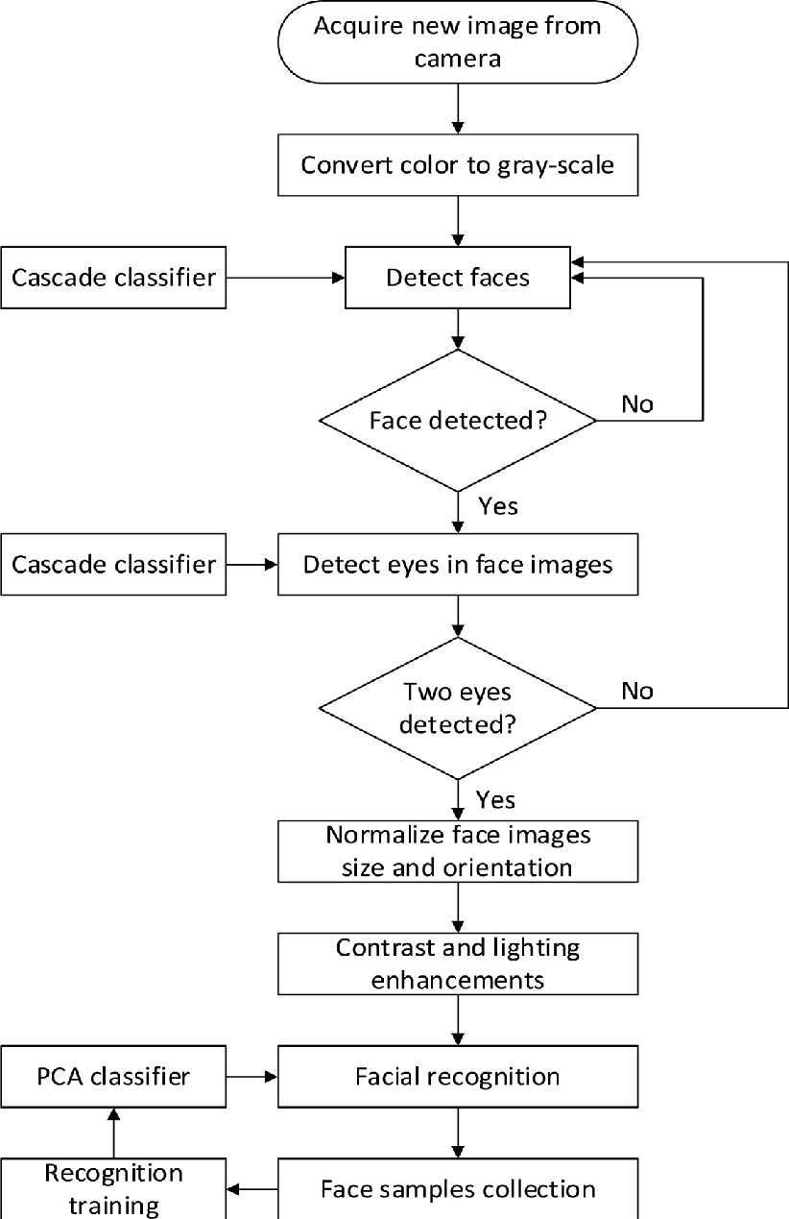
Flow chart:

Slide 6
Concepts applied:
Library and Module used:
Face recognition
Python open cv library
OS (operating system)
Pickle
Numpy
CSV (comma separated values)
Time and DateTime
Sklearn ( Machine Learning Algorithm)
Streamlit
Pandas
Haarcascade classifier ▪ Image processing
We have used all these libraries in this project .

Slide 7
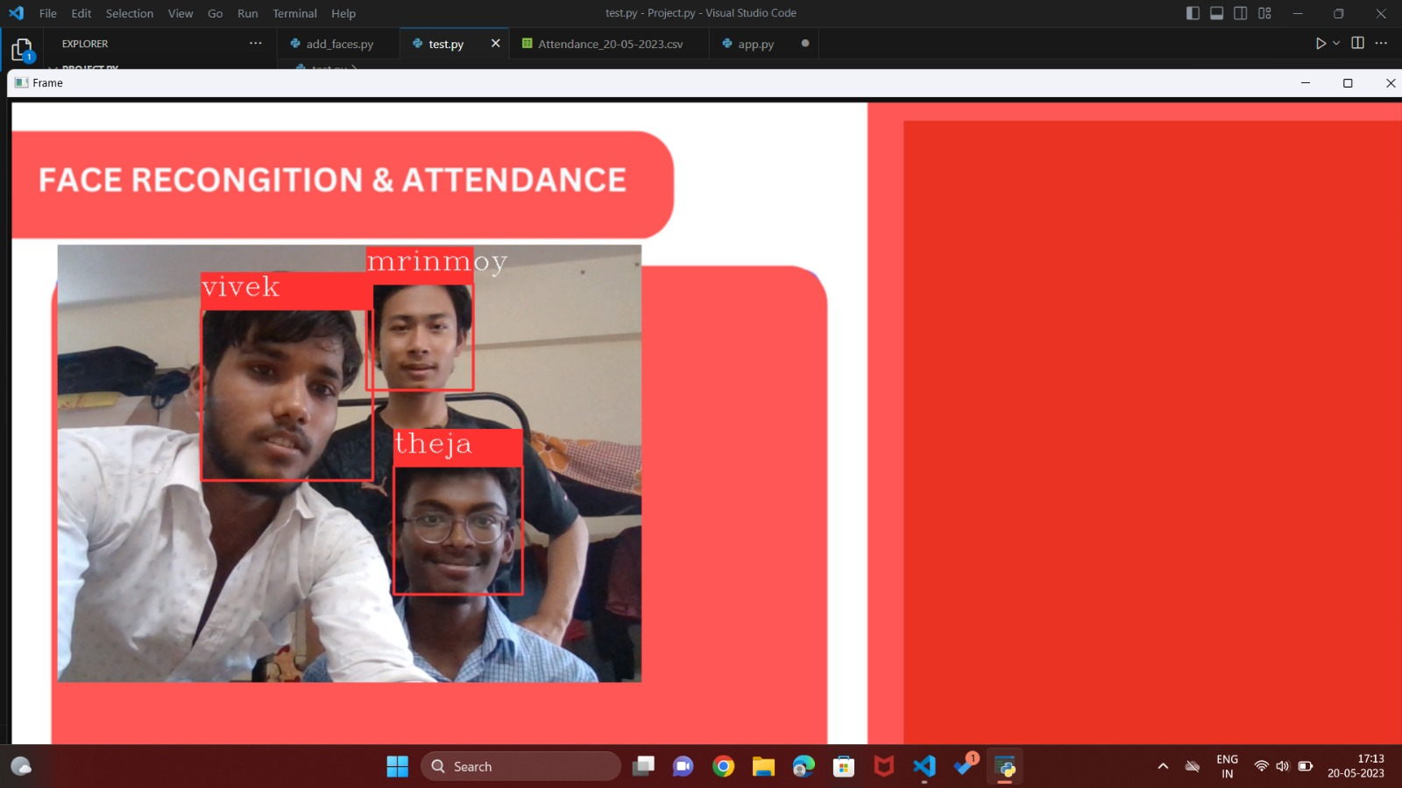
Implementation screen shots:

Slide 8
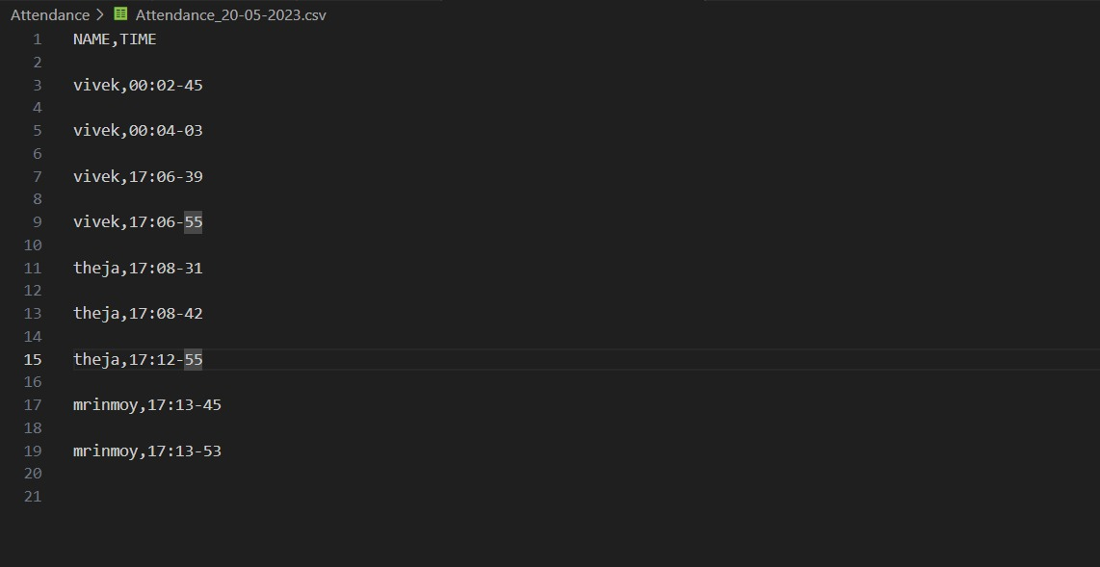

Slide 9
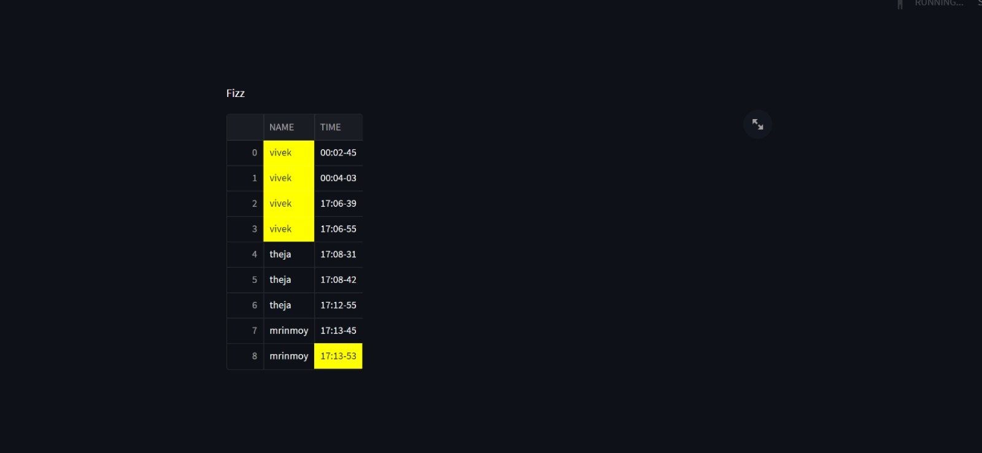

Slide 10
ACKNOWLEDGEMENT
Gratitude towords:
Ms. M. Chiradevi Mam (CC)
K. Manikanta (Tutor sir)
Thank you for sharing your knowledge and showing great support.

Slide 11
Thank you

